Slide 1


Ryan Hill
11 August 2023

Slide 2





OUTLINE
Executive Summary
Introduction
Methodology
Results
Visualization – Charts
Dashboard
Discussion
Findings & Implications
Conclusion
Appendix

Slide 3

Executive Summary
Predict the success of a launch and the success of the recovery of the first stage in order to determine pricing strategies for future clients
Determine the key factors in determining where to locate a launch site
Summary of methodologies
Data collection & wrangling using APIs, BeautifulSoup, and One Hot Encoding
EDA with Visualizations and SQL
Interactive analysis with Folium Maps and Dash
Predictive analysis using Decision Tree Classifier, SVM, KNN, & Logistic Regression
Summary of all results
Decision Tree Classification model performed the best on the test group
Interactive analytics using Folium Maps concluded that proximity to the coast, interstate hwys, railroads, and urban areas are key factors for site location
Visualizations provided key insights when performing EDA

Slide 4
Introduction
The commercial Space Industry has become one of the fastest growing industries in the 21st Century. As technology has rapidly evolved in both the computing power of computers and rocketry, the cost of getting a payload into Space has decreased precipitously, leading to a commercial rush to Space tourism and other private sector possibilities. This project evaluates how a new competitor into the market can analyze currently available data in order to answer fundamental questions on how to survive in the industry.
Key Questions to Answer:
Where should a new competitor locate their launch facilities?
How much should a new competitor charge per launch/payload?
Predict the probability of recovering the first stage to improve cost estimates
What factors are most important in determining a successful launch?

Slide 5

Section 1

Slide 6
Methodology
Executive Summary
Data collection methodology: Data was collected using a SpaceX API to send a get request to a defined URL or by using the HTML Web Scraping API BeautifulSoup
Perform data wrangling: Data was first Normalized, then filtered for desired information, sampled to explore what further wrangling needed to be performed including the removal of null values, and finally put into a searchable data frame. One Hot Encoding was used to perform these tasks.
Perform exploratory data analysis (EDA) using visualization and SQL
Perform interactive visual analytics using Folium and Plotly Dash
Perform predictive analysis using classification models
Determine the model that performs the best

Slide 7
Data Collection – SpaceX API & BeautifulSoup
Collect Data using SpaceX REST API using the “Get” request from 4 endpoints on a SpaceX URL and normalize into a data frame.
Collect Data using HTML websites and BeautifulSoup and parse data into a panda data frame.
External Reference:
https://github.com/RMHUNC/Space-Y/blob/682bdd1631419b129111edc9ecd4034bc7128a13/spacex-data-collection-api.ipynb
https://api.SpaceXdata.com/V4/
/capsules
Start
/launches/past
Response
(json)
/cores
Start
HTML
(Wiki)
Response
(soup pd df)

Slide 8
Data Collection – Wrangling
Scraping (cleaning) Process:
Normalize the Data
Filter the Data
Sample the Data & Clean further (deal w/nulls)
Aggregate Data into Searchable DF
External Reference:
https://github.com/RMHUNC/Space-Y/blob/a5e9bbf2ebaea82112d6f515a61fdca55242cfb3/spacex-data_wrangling_jupyterlite.jupyterlite.ipynb
Start
Searchable
Data Frame
API Response
(Normalize)
Filter Data
Sample
Data &
Clean Further
(remove nulls)

Slide 9
EDA with Data Visualization
Charts & Graphs Plotted
Scatterplot of Launch Number by Payload Mass overlayed by Success or Failure
This was done to see if the first stage was more likely to land successfully as the flight number increased, and how payload mass affected the likelihood of a successful first stage return.
Flight Number Versus Launch Site:
To see if there is a correlation between flight number and launch site
Payload Size Versus Launch Site:
To see if payload size determined the launch site
Average Success Rate Versus Orbit (Bar):
To see if some Orbits have a higher rate of success
Flight Number Versus Orbit Type:
To see if the company decided to focus on a particular orbit type over time
Payload Mass Versus Orbit Type:
To see if there is a relationship between the payload mass and orbit type
Annual Launch Success Rate Over Years(Line):
To see if the company became more successful at launches over time
External Reference:
https://github.com/RMHUNC/Space-Y/blob/682bdd1631419b129111edc9ecd4034bc7128a13/EDA%20with%20Visualizations.ipynb

Slide 10
EDA with SQL: Summary of Queries
Display the names of the unique launch sites in the space mission
Display 5 records where launch sites begin with the string 'CCA'
Display the total payload mass carried by boosters launched by NASA (CRS)
Display average payload mass carried by booster version F9 v1.1
List the date when the first successful landing outcome on a ground pad was achieved
List the names of the boosters which have success in drone ship and have payload mass greater than 4000 but less than 6000
List the total number of successful and failure mission outcomes
List the names of the booster versions which have carried the maximum payload mass using a subquery
List the records which will display the month names, failure landing outcomes in drone ship ,booster versions, and launch site for the months in year 2015
Rank the count of landing outcomes (such as Failure (drone ship) or Success (ground pad)) between the date 2010-06-04 and 2017-03-20, in descending order
External Reference:
https://github.com/RMHUNC/Space-Y/blob/682bdd1631419b129111edc9ecd4034bc7128a13/jupyter-labs-eda-sql-coursera_sqllite(2).ipynb

Slide 11
Build an Interactive Map with Folium
Map objects included on the Folium Interactive Map:
Marker Icons/labels: Showing Points of Interest: Railway, Highway, City, Coast
Marker Circles: Showing launch sites
Marker Clusters: Showing successful and failed launches by launch site
PolyLines showing Distance between points
The objects included on the Folium Map are used to identify the locations of successful and failed launches, as well as their proximity to relevant cost saving and safety points to assist in determining where a new competitor should look to locate.
https://github.com/RMHUNC/Space-Y/blob/682bdd1631419b129111edc9ecd4034bc7128a13/LaunchSiteLocationAnalysis.jupyterlite.ipynb

Slide 12
Build a Dashboard with Plotly Dash
Dash Graphs:
Pie Chart showing the Total Number of Successful Launches Count
Pie Chart showing the Percentage of Successful versus Unsuccessful Launches by Launch Location
Scatter plot with payload slider showing Successful versus Unsuccessful Launch by Payload Overlaid by Rocket Booster Version
These interactive graphs allow an end user to analyze what booster versions are the most successful and to determine the relationship between payload and launch success, and between launch site and launch success.
External Reference:
https://github.com/RMHUNC/Space-Y/blob/f6e91322649d74ea1e5c7b36bf614979314a104f/spacex_dash_appfinal.py

Slide 13
Predictive Analysis (Classification)
A classifier was added to the Data, then the Data was standardized
The Split_Train_Test function was used on Decision Tree Classification, Logistic Regression, KNN, & SVM. The Confusion Matrix and accuracy for all models were compared and then the models were cross compared to determine the best model.
https://github.com/RMHUNC/Space-Y/blob/3310efec1955e31028f417ab6abef4492460531e/SpaceX%20Machine%20Learning%20Analysis%20Capstone-Final.ipynb
Split Data into
Training(.8) & Test(.2)
Sets
Find the Best
Hyperparameter
Create
Classifier
Column
Decision Tree Classification
Logistic Regression
SVM (Support Vector Mach)
KNN (k-Nearest Neighbor)
Find the Model
that works best for Test Data
Standardize
The Data

Slide 14
Results
The Success rates for SpaceX launches is directly proportional to the launch number over time. They become more successful at launches over time.
Launch pad KSC LC 39A had the most successful launches
Heavier payloads have a lower success rate than lighter payloads
Launches to ES-L1, GEO, HEO, & SSO Orbits were the most successful
Average Payload Mass has increased over time
Vandenburg Air Force Base (VAFB) is the least frequently used launch site
The Decision Tree Classification Model worked best on predicting the outcome of the test group with an accuracy score of 86%.

Slide 15

Section 2

Slide 16
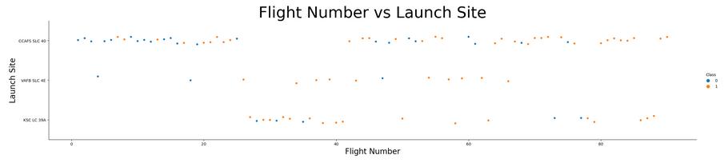
Flight Number vs. Launch Site
It is clear that Vandenburg Air Force Base is infrequently used and has a high failure rate
Cape Canaveral Space Force Center handles the majority of all launches

Slide 17
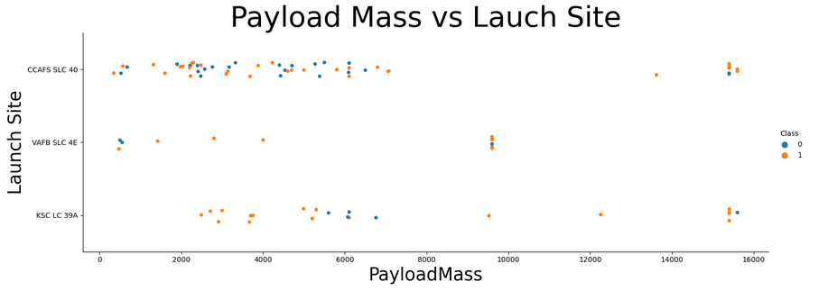
Payload vs. Launch Site
Kennedy Space Center is used predominately for Payload launches between 2000-6500kg
Vandenburg AFB is used predominately for low Payload launches

Slide 18
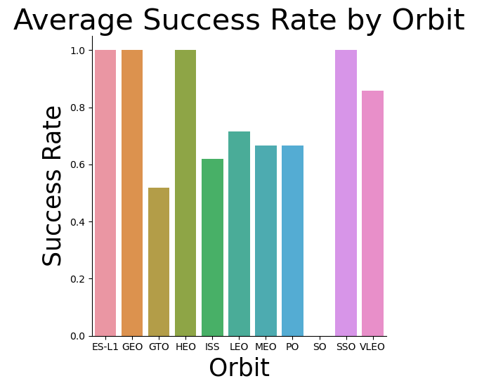
Success Rate vs. Orbit Type
The ES-L1, GEO, HEO, & SSO Orbits had the highest success rate of all the Orbits.
The SO had the lowest success rate at 0%, followed by the GTO at around 50%

Slide 19
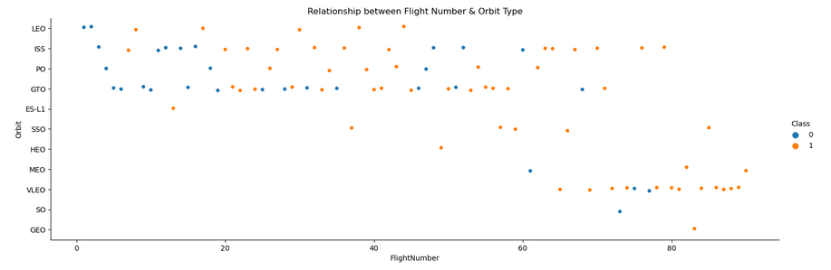
Flight Number vs. Orbit Type
Over time there is a trend towards launches to VLEO, perhaps because they are profitable

Slide 20
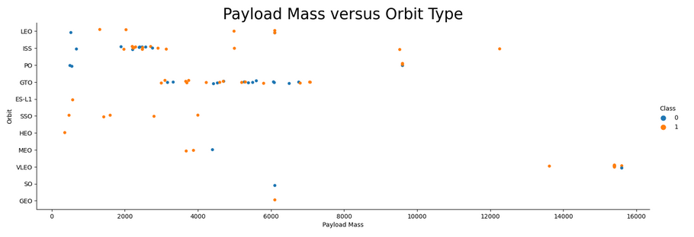
Payload vs. Orbit Type
Payloads to ISS tend to be between 2,000-3,000kg
Payloads to GTO tend to be between 3,000-7,000kg

Slide 21
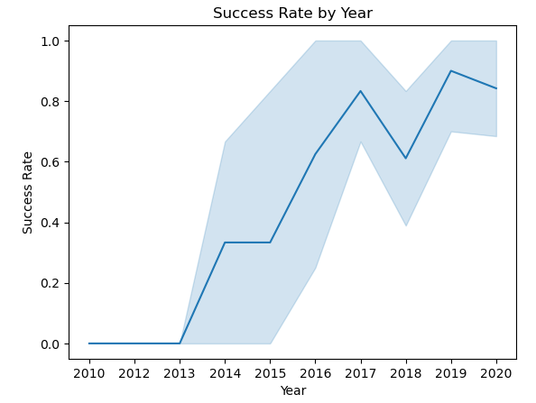
Launch Success Yearly Trend
SpaceX’s Launch Success Rate Greatly improved over time

Slide 22
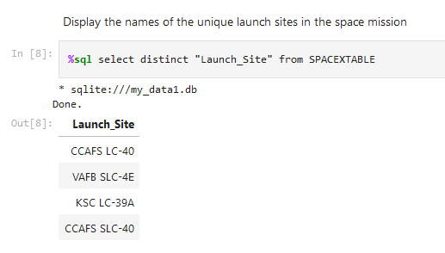
All Launch Site Names
CCAFS LC-40
Cape Canaveral Space Force Center
VAFB SLC-43
Vandenburg Air Force Base
KSC LC-39A
Kennedy Space Center
CCASF SLC-40
Cape Canaveral Space Force Center

Slide 23
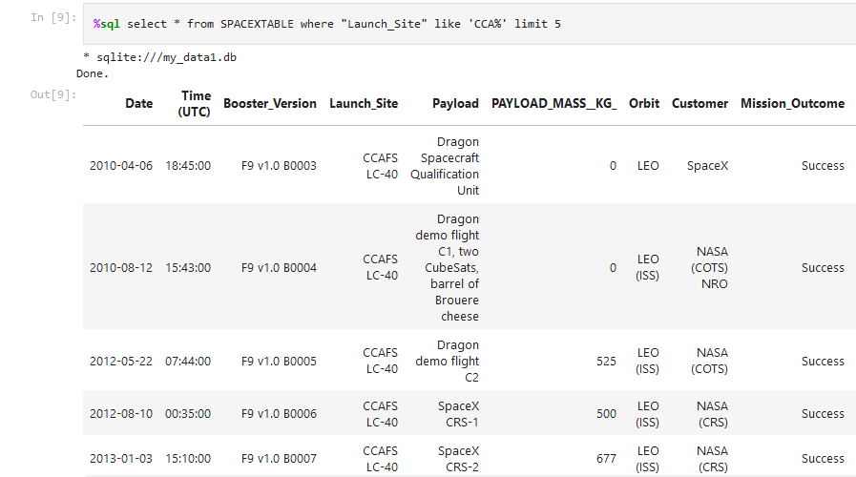
Launch Site Names Begin with 'CCA'
Display of 5 records where the launch site begins with the string “CCA”
Narrow the results by using “limit”

Slide 24
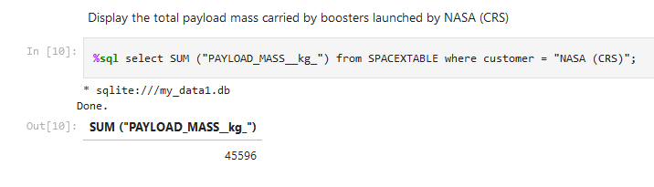
Total Payload Mass
The total mass launched by NASA(CRS) was 45,596kg

Slide 25
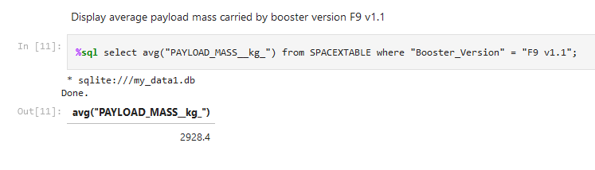
Average Payload Mass by F9 v1.1
The average payload mass carried by booster F9v1.1 was 2,928.4 kg

Slide 26
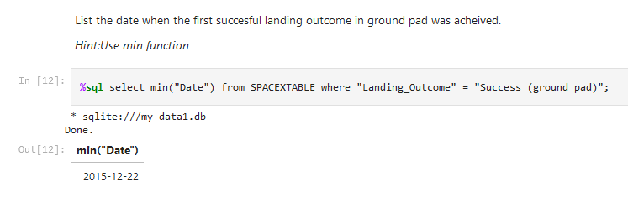
First Successful Ground Landing Date
The first successful landing on a ground pad occurred on Dec. 22, 2015

Slide 27
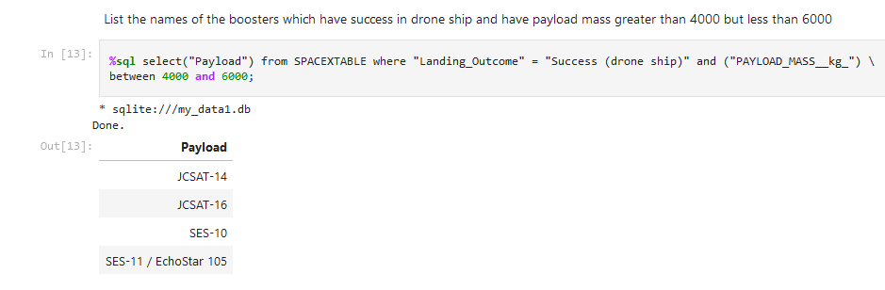
Successful Drone Ship Landing with Payload between 4000 and 6000

Slide 28
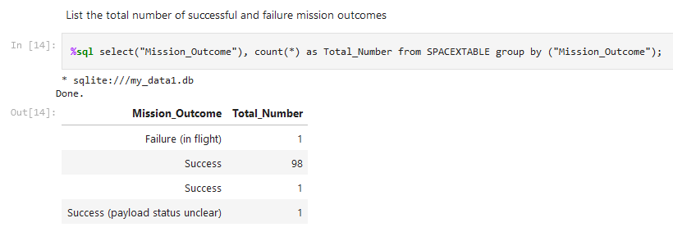
Total Number of Successful and Failure Mission Outcomes
The total number of successful mission outcomes is 100 with only 1 failure

Slide 29
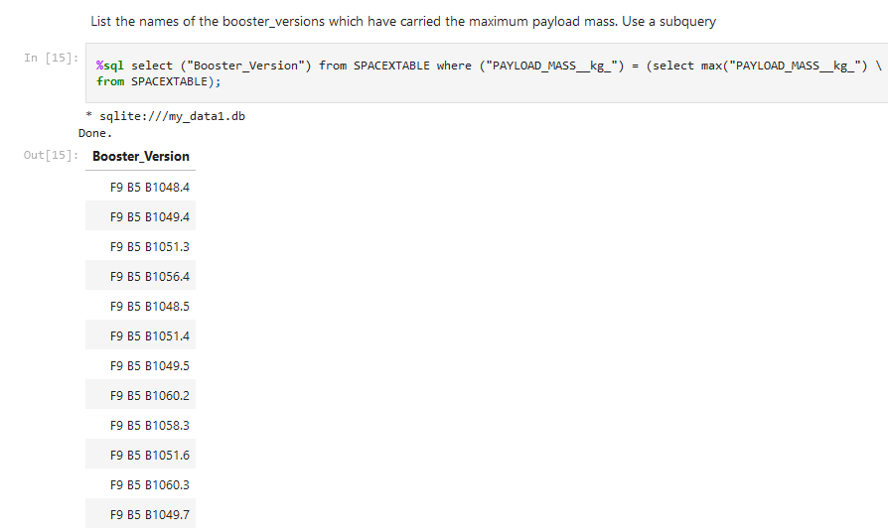
Boosters Carried Maximum Payload
Using a subquery, one can see that several booster versions have carried the maximum payload.

Slide 30
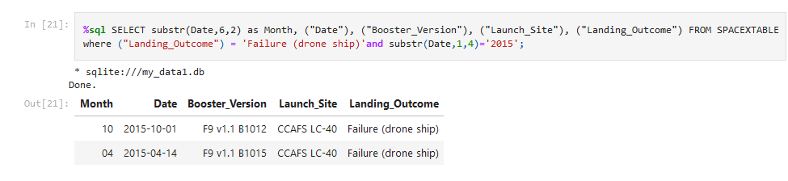
2015 Launch Records
Display of the month names, failure landing outcomes in drone ship, booster versions, launch site, and for the months in year 2015

Slide 31
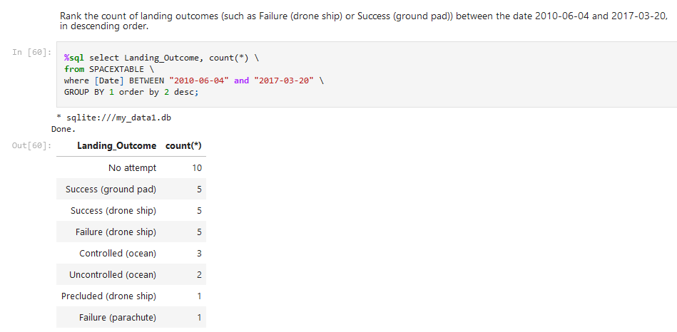
Rank Landing Outcomes Between 2010-06-04 and 2017-03-20

Slide 32

Section 3

Slide 33
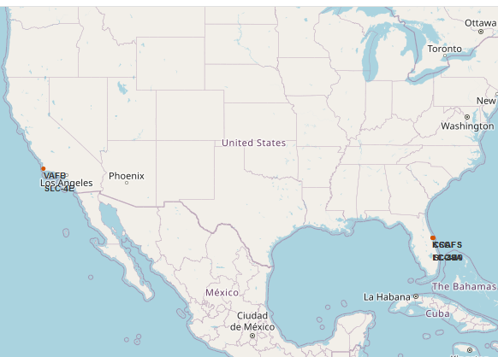
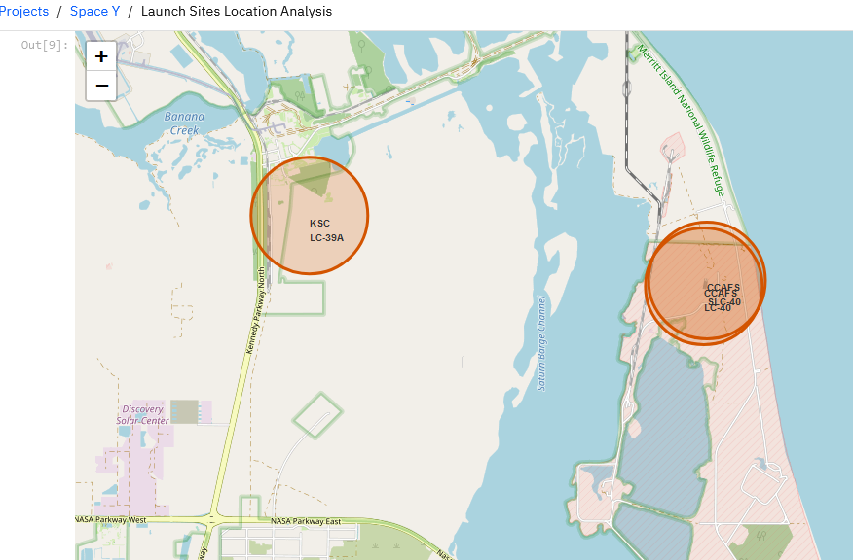
Folium Maps Showing all 4 Launch Sites

Slide 34
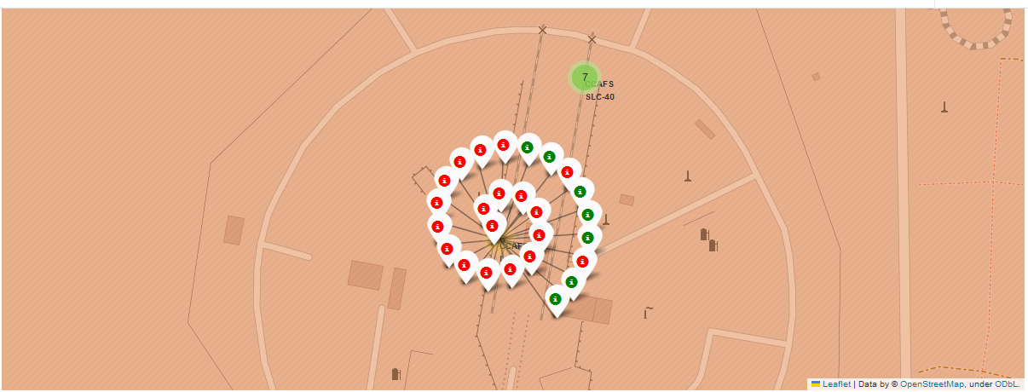
Map of Success vs Failures of a Launch Site
This screenshot shows each instance of a successful (green) or failed (red) launch at launch site CCASF- LS40. It is important to be able to see the success and failure rates at each launch site to see if any conclusions can be made.

Slide 35
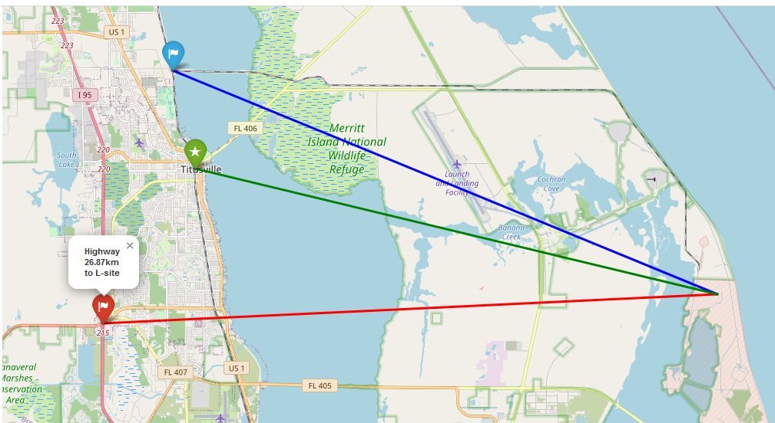
Proximity of Relevant Geographical Features to a
Launch Site

Slide 36

Section 4

Slide 37
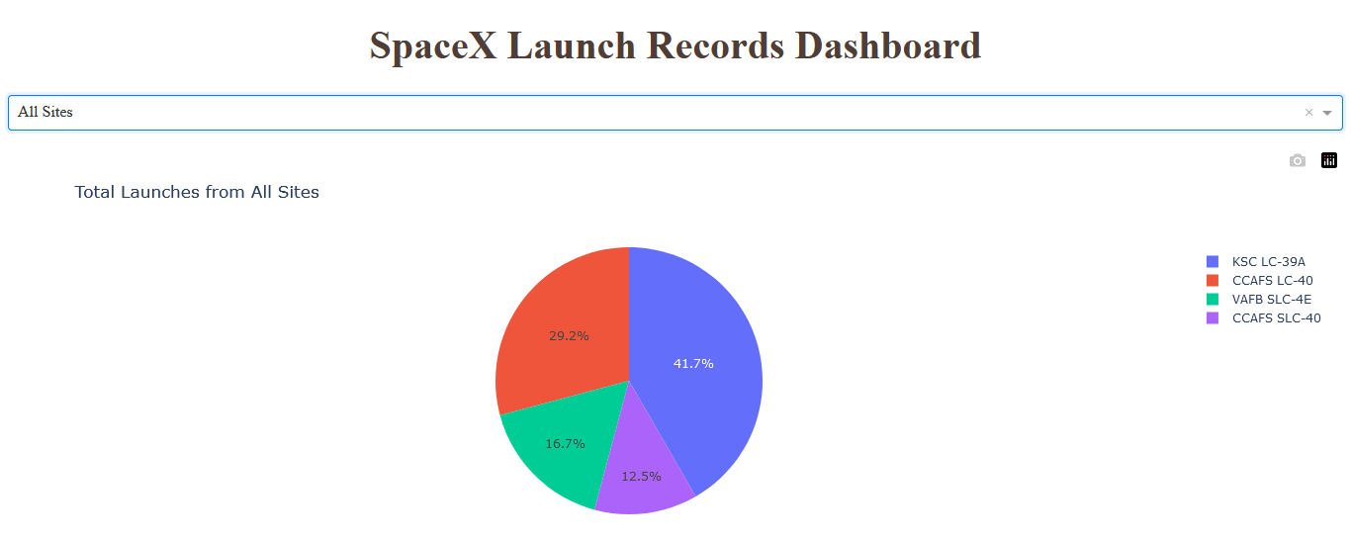
Total Successful Launches by Launch Site
This chart tells one which launch sites have the most successful number of launches

Slide 38
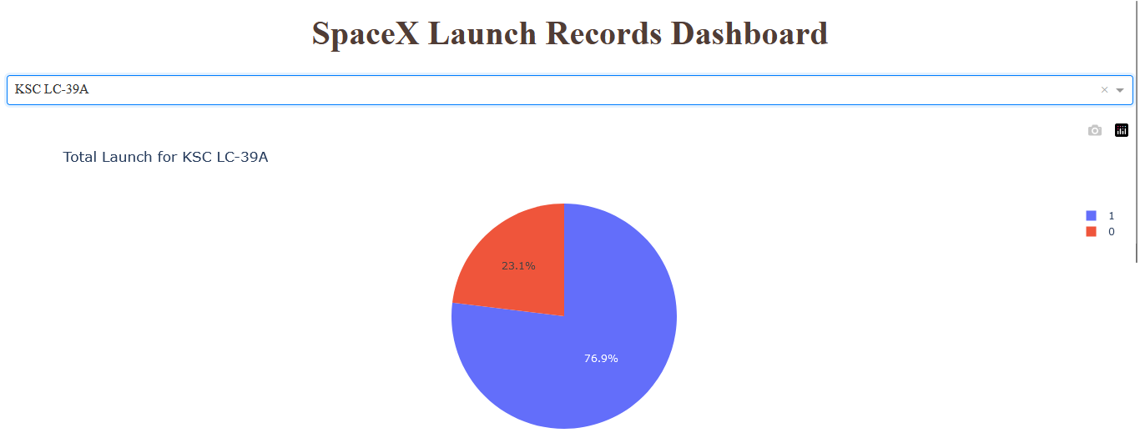
Launch Site with the Highest Percentage Success Rate
Kennedy Space Center’s LC-39A had the highest percentage of successful launches at 76.9%

Slide 39

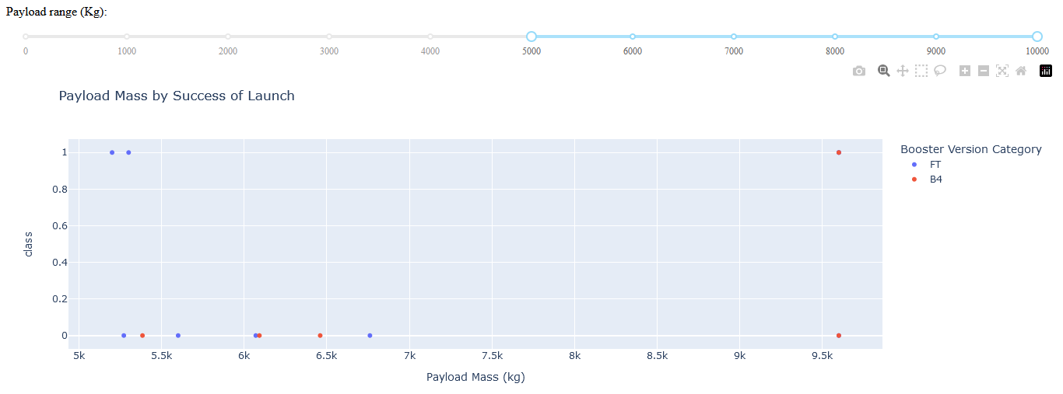
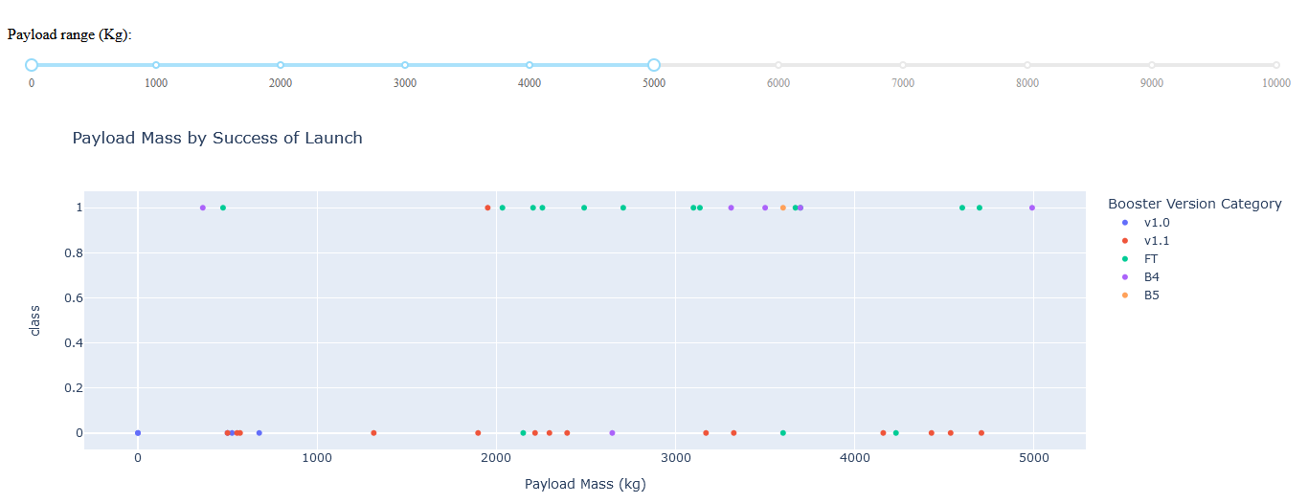
Success Rate of Booster Version by Payload
.
The FT Booster performs best in both the >5000kg Payload & in the <5000kg Categories

Slide 40

Section 5

Slide 41
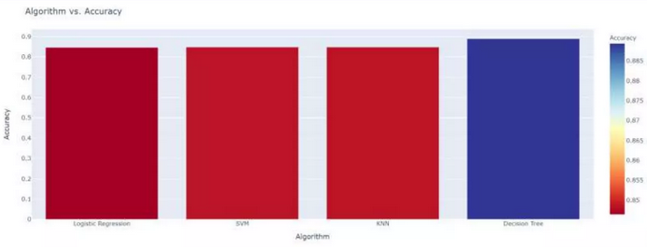
Classification Accuracy
The Decision Tree Classification model had the highest accuracy rate at 88.8%

Slide 42
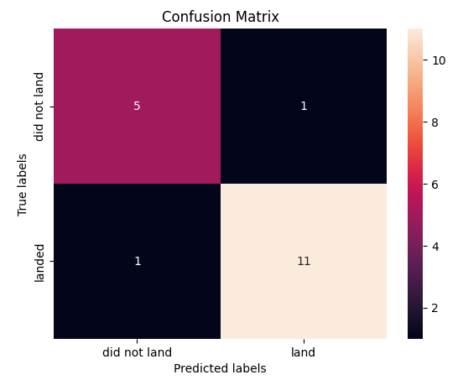
Confusion Matrix
Decision Tree Confusion Matrix
The decision tree classification model performed the best on the test set
It resulted in only 1 False Positive & 1 False Negative
It accurately predicted 5 out of 6 failures
It accurately predicted 11 out of 12 successful outcomes
It’s accuracy rate was 86.9% when paired with the highest reliability rate

Slide 43
Conclusions
The FT Booster has the highest success rate in both low and high Payload Mass launches indicating that it is very reliable and should be used whenever possible.
Launch site location should be near the coast for safety reasons, and close to railways, interstate highways, and urban centers for economic reasons.
SpaceX has learned from their mistakes as their launch success rate as improved greatly over time
The SO and GTO Orbits should be avoided as they may not be profitable until more analysis is conducted into their high failure rate
One important factor NOT taken into account in this project was the weather conditions during booster recovery. Since it can play an important role on recovery success, further analysis should be done which includes weather as a variable for recovery success

Slide 44
Appendix
All codes and analysis can be found on my GitHub SpaceY repository
https://github.com/RMHUNC/Space-Y
I would like to take all the Instructors and Teaching Assistants at IBM for all the hard work they put into teaching the Data Science Professional Certification Program!
Link to Github pdf of this presentation:
SpaceXPowerPointPresentationPDF

Slide 45


